Slide 1
Democratic Backsliding II
POL1036: Comparative European Politics – Lecture 16
30/03/2026

Slide 2
Recap: (Ideal) Regime Types
 | Democratic | Authoritarian/Autocratic
Elections | Free and fair | Restricted, unfair and uncompetitive
Citizen Participation | Promoted | Minimal
Governance | Accountable & transparent | Unaccountable & corrupt
Separation of Powers | Independent judiciary, executive and legislative | Limited autonomy, under state control
Lawfulness | Rule of Law | Rule by law

Slide 3
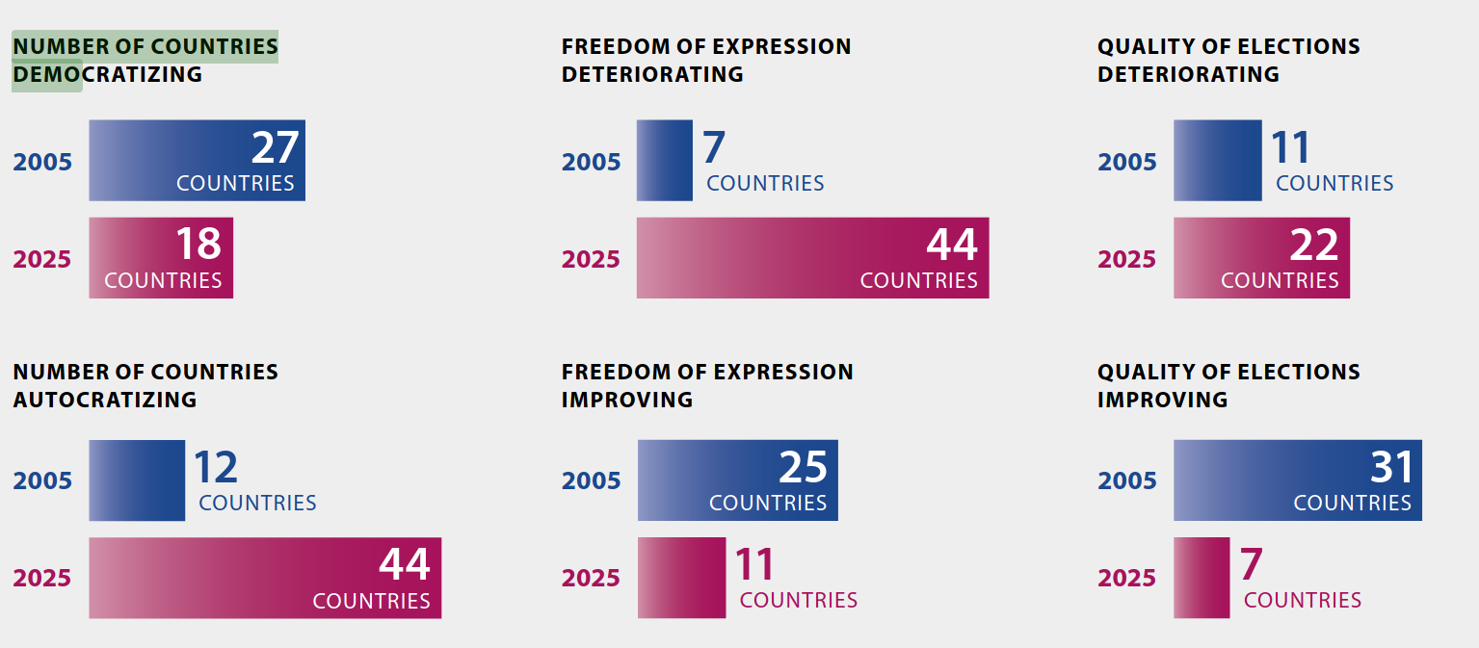
Recap: Democratic quality is eroding ( = backsliding)
Source: V-Dem Democracy Report 2026. https://www.v-dem.net/documents/61/v-dem-dr__2025_lowres_v2.pdf

Slide 4
Democratic backsliding, at its most basic, denotes the state-led debilitation or elimination of any of the political institutions that sustain an existing democracy. (Bermeo, 2016)

Slide 5
Recap: Hybrid Regimes
Combine democratic rules with authoritarian governance
Many different terms
“semidemocracy”
“virtual democracy”
“electoral democracy”
“pseudodemocracy”
“illiberal democracy”
“semi-authoritarianism”
“soft authoritarianism”
“electoral authoritarianism”
…
Competitive Authoritarian Regimes (CARs) -> Levitsky & Way (2002, 2010, 2020)

Slide 6
Recap: CARs: Elections without Democracy
(Diminished) form of authoritarianism
Hybrid:
Formal democratic institutions = principal means to obtain & exercise political authority (democratic)
BUT incumbents systematically and aggressively violate these rules in order to gain advantage (autocratic)

Slide 7
Recap: The New Face of Competitive Authoritarianism
Hungary, Turkey, Montenegro, Serbia, … : need for greater skill, more sophisticated strategies, and far more extensive popular mobilization
Create sizeable electoral majority
Use referendums or hypermajoritarian strategies to change rules of the game
Weaken opponents, lock in prospective autocrats’ hold on power

Slide 8
How does democratic competition create the conditions for democratic backsliding, and how does the erosion sustain or deepen?

Slide 9
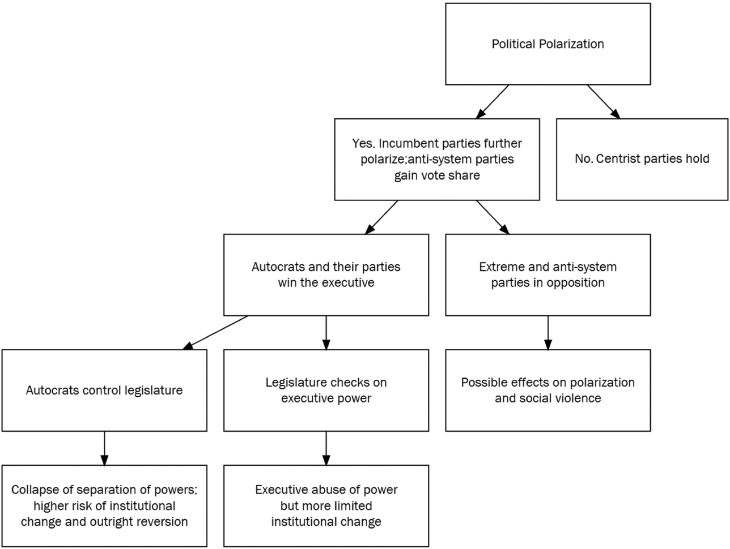
Haggard & Kaufman 2021, p. 5
1
2
3

Slide 10
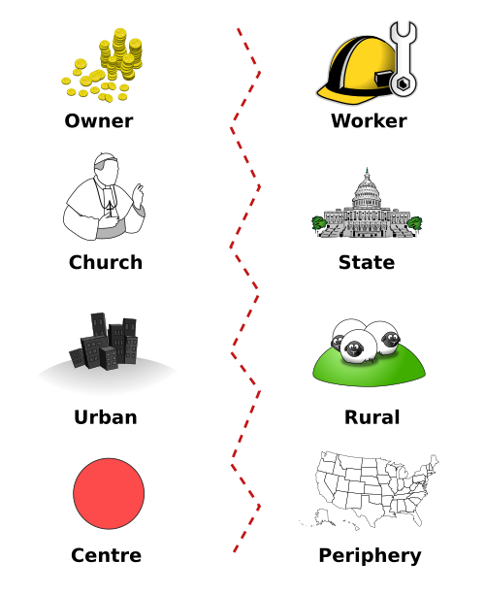
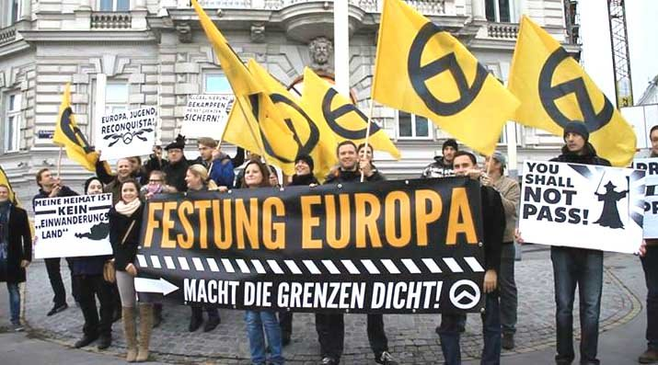
Political Polarization
Owner
Worker
Church
State
Industry
Rural
Centre
Periphery
Reinforcing cleavages among publics and elites on policies and ideologies lead to partisan division "us" vs "them"

Slide 11
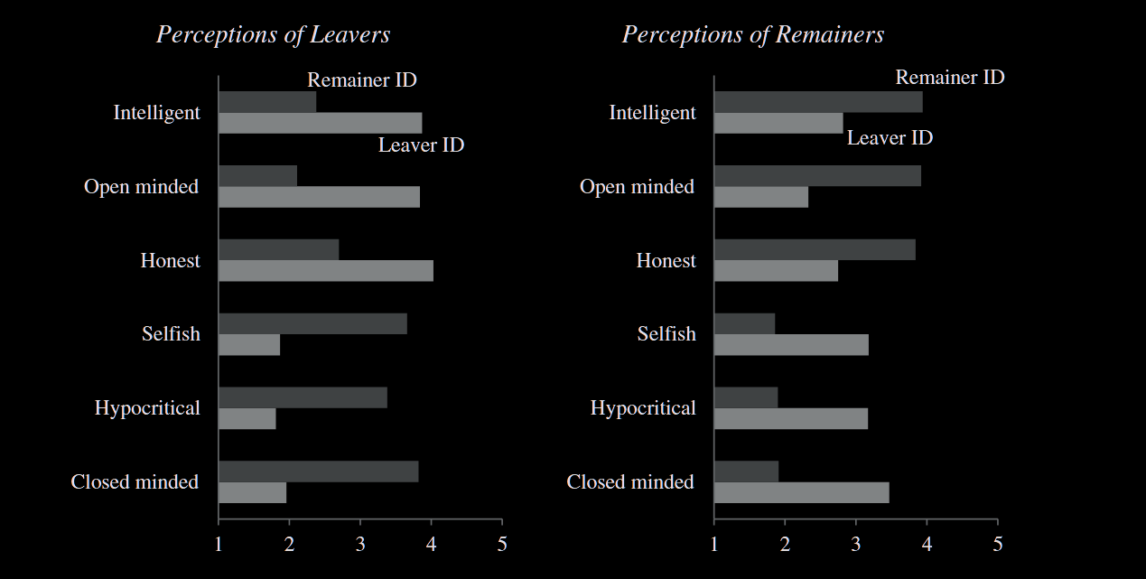
Example: Affective Polarization on Brexit
Source: Hobolt et al. (2021: 1485)

Slide 12


Polish Polarization and the rise of PiS
Early 2000s: Party system realignment along existing cultural cleavages
Civic platform
urban, liberal
Law & Justice
Traditional, populist, rural
+nationalist, anti-EU, & elite resentment

Slide 13
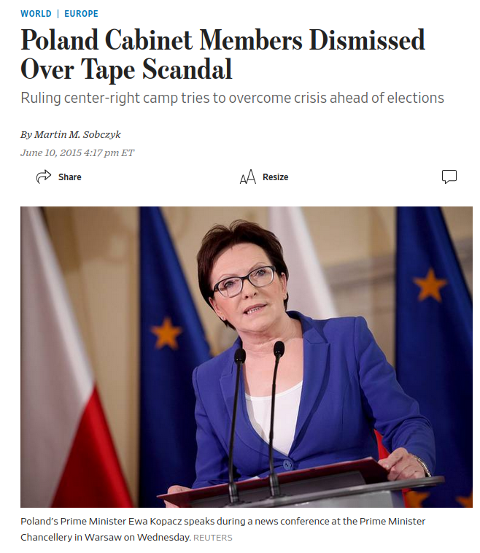
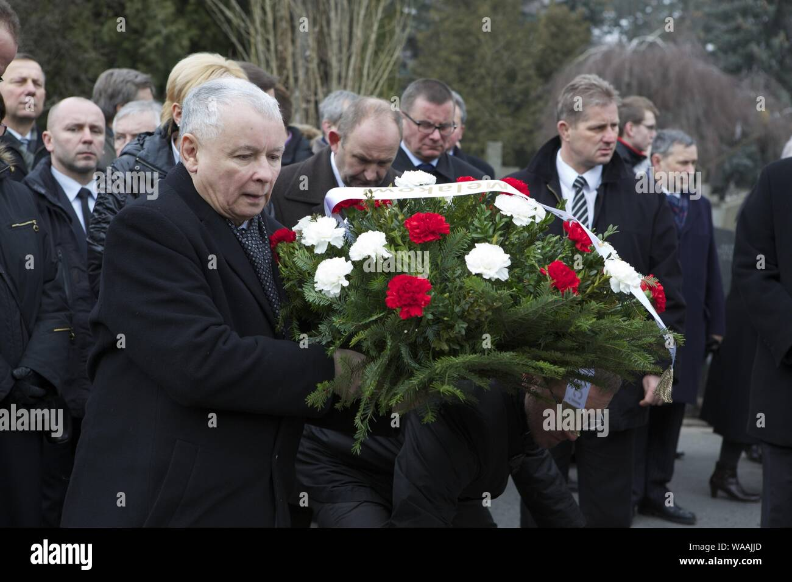
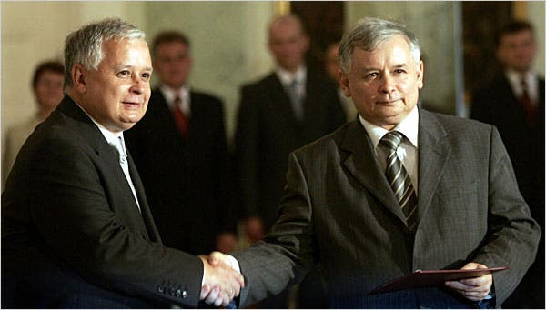

Smolensk (2010) + "Tape affair" (2014)

Slide 14
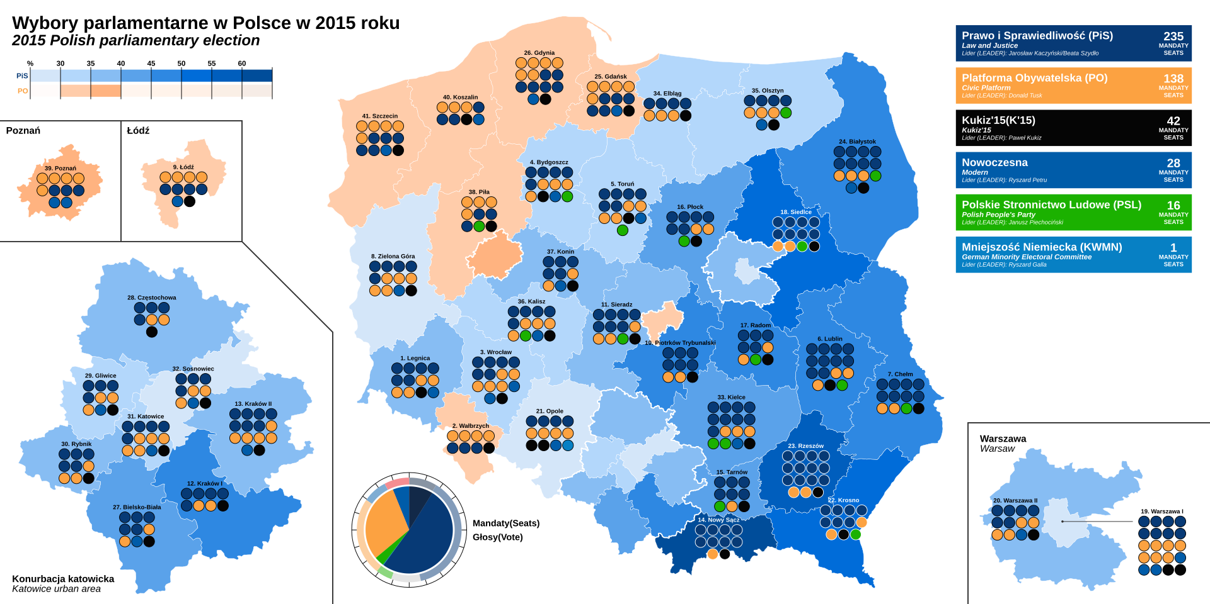
2015 parliamentary elections

Slide 15
Support for center decreases while autocratic electoral appeal rises. If the center does not hold, chances of backsliding increase dramatically.
(Haggard & Kaufman 2021)

Slide 16
The autocratic electoral playbook
Salient & polarizing issue(s)
With a hint of anti-democratic tendencies
Migration
Corruption
Anti-establishment
Economic inequality
Gender issues
European integration
Emphasis on "will of the people"
Overhaul/destroy 'ineffective' rules of the game
Undermine legitimacy of opponents
Curtail civil liberties
Tolerate violence

Slide 17

How do voters tend to respond? Svolik et al. (2023)

Slide 18
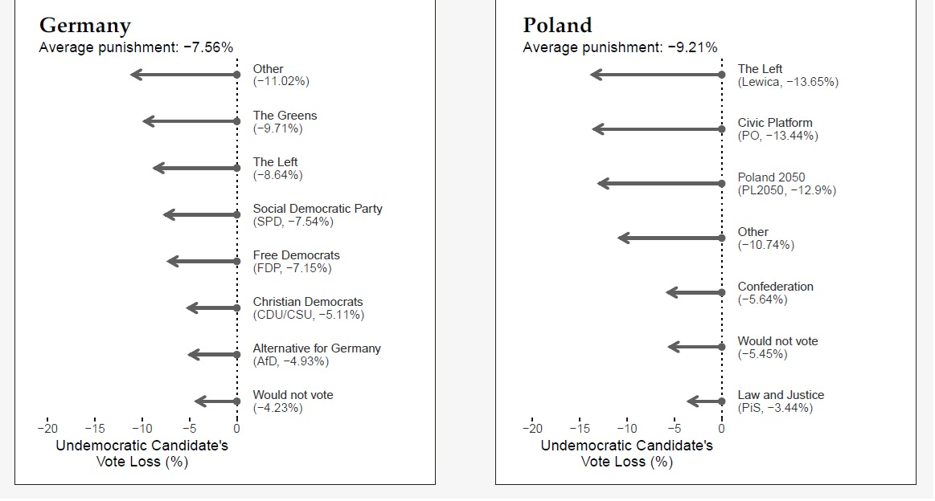
Undemocratic discourse is mostly punished on the left, and not so much on the right

Slide 19
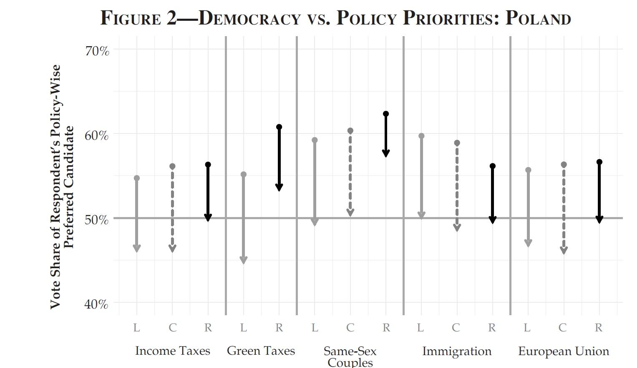
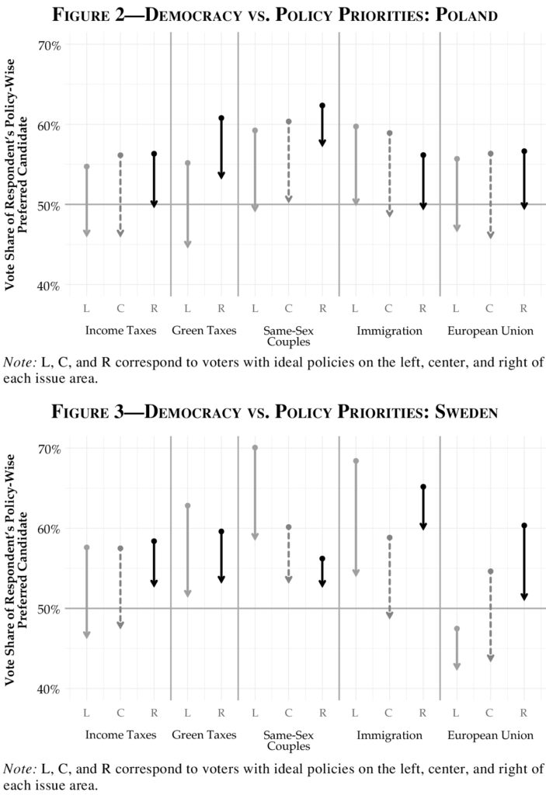
Undemocratic discourse is mostly punished on the left, and not so much on the right

Slide 20
Starting the democratic descent
2. Autocrats win executive & legislature
3. Start "stealthing" towards democratic erosion
Pull traditional parties from center
Legitimize discourse
Win elections
Control the executive
Hold legislative majority (alone or in coalition)
Slowly push normative limits
Change laws to weaken checks & balances (press, electoral system, judiciary, parliamentary oversight)
Veil of popular support
Self-compounding

Slide 21
The endgame is a collapse of the separation of powers, allowing for all-out attacks on the rights and liberties of opponents
Notes:
We bring all of the things we talked about over the last few weeks together.

Slide 22
How does this work in practice? C.f. CARs
Attack on civil liberties
Subtle
Use of “legal repression”: discretionary use of legal regimes to punish opponents -> selective and partisan instead of universal
Raises costs of opposition activities

Slide 23
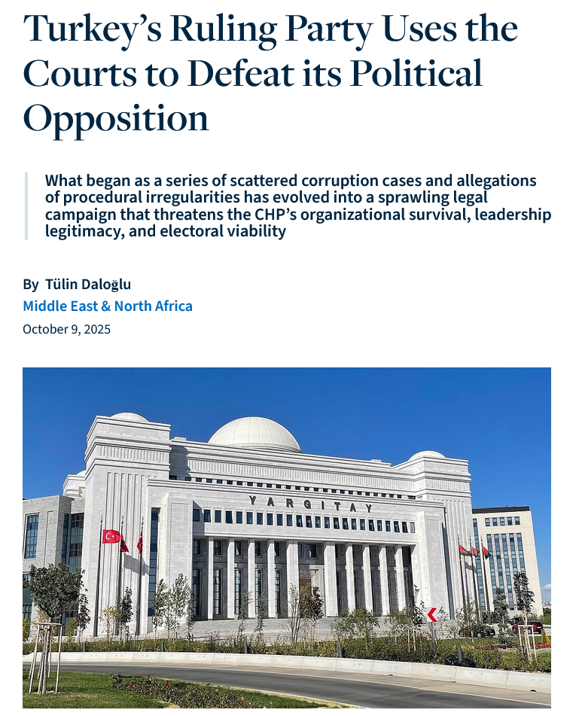
Case: Turkey and the prosecution of the opposition
Ruling Justice and Development Party (AKP, Erdoğan) vs. opposition Republican People’s Party (CHP)
Over last year: massive crackdown on CHP in name of “Octopus of Corruption” (read more)
Over 500 members detained and 220 jailed by July, more since
Includes many mayors such as Istanbul’s İmamoğlu
Alleged bribery at 2023 national congress that appointed Ozgur Ozel as leader of CHP
Result: asset freezing, endless litigation, fragmented leadership
Party’s organizational survival in peril
https://www.stimson.org/2025/turkeys-ruling-party-uses-the-courts-to-defeat-its-political-opposition/

Slide 24
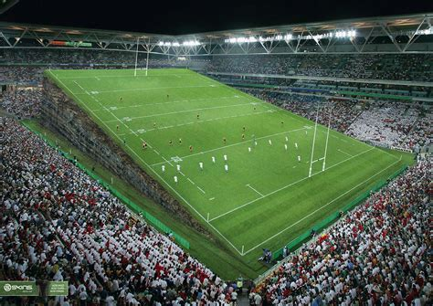
How does this work in practice? C.f. CARs
Attack on civil liberties
Cultivating an uneven playing field

Slide 25
How does this work in practice? C.f. CARs
Attack on civil liberties
Cultivating an uneven playing field via uneven access to resources
Less subtle ways:
Direct partisan use of state resources
Systematically deploying state machinery for election campaigns (buildings, employees, communication infrastructure, …)

Slide 26
How does this work in practice? C.f. CARs
Attack on civil liberties
Cultivating an uneven playing field via uneven access to resources
Less subtle ways
More subtle: Monopolize access to private-sector finance through control of credit, licenses, state contracts for enrichment, ….
Party-owned enterprises
Benefit certain firms that contribute to ruling party
Deny opposition parties access to resources (tax controls, …)

Slide 27
Case: AKP’s weaponizing of state-business relations Turkey to establish CAR (Esen & Gumuscu, 2017)
Since coming to power in 2002: AKP promoted capital accumulation among supporters
Partisan allocation of natural resources, public property and state monopolies
Created and cultivated a pro-AKP business class
Cracked down on rival entrepreneurs via taxation
In return: finance of pro-government media & AKP’s electoral campaigns

Slide 28
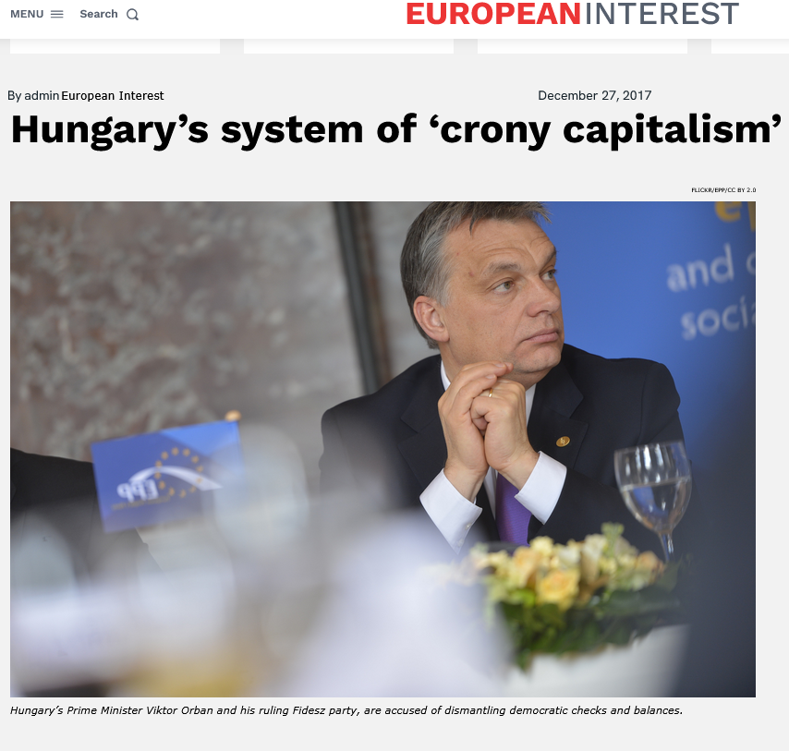
Case: Hungary’s EU-funded “Crony Capitalism”
Cronyism = awarding positions, gov. contracts, loans and advantages to friends/associates
Fidesz supermajority -> helping favored businesspeople (i.e. family and friends) land state contracts (mostly funded by EU) and EU agricultural subsidies
Many examples of “cash-burning”: https://telex.hu/english/2024/05/22/abszurd-penzegetesek-unios-forrasbol
Business now largely dependent on political loyalty -> market for donations is cornered by Fidesz
https://www.europeaninterest.eu/hungarys-system-crony-capitalism/

Slide 29
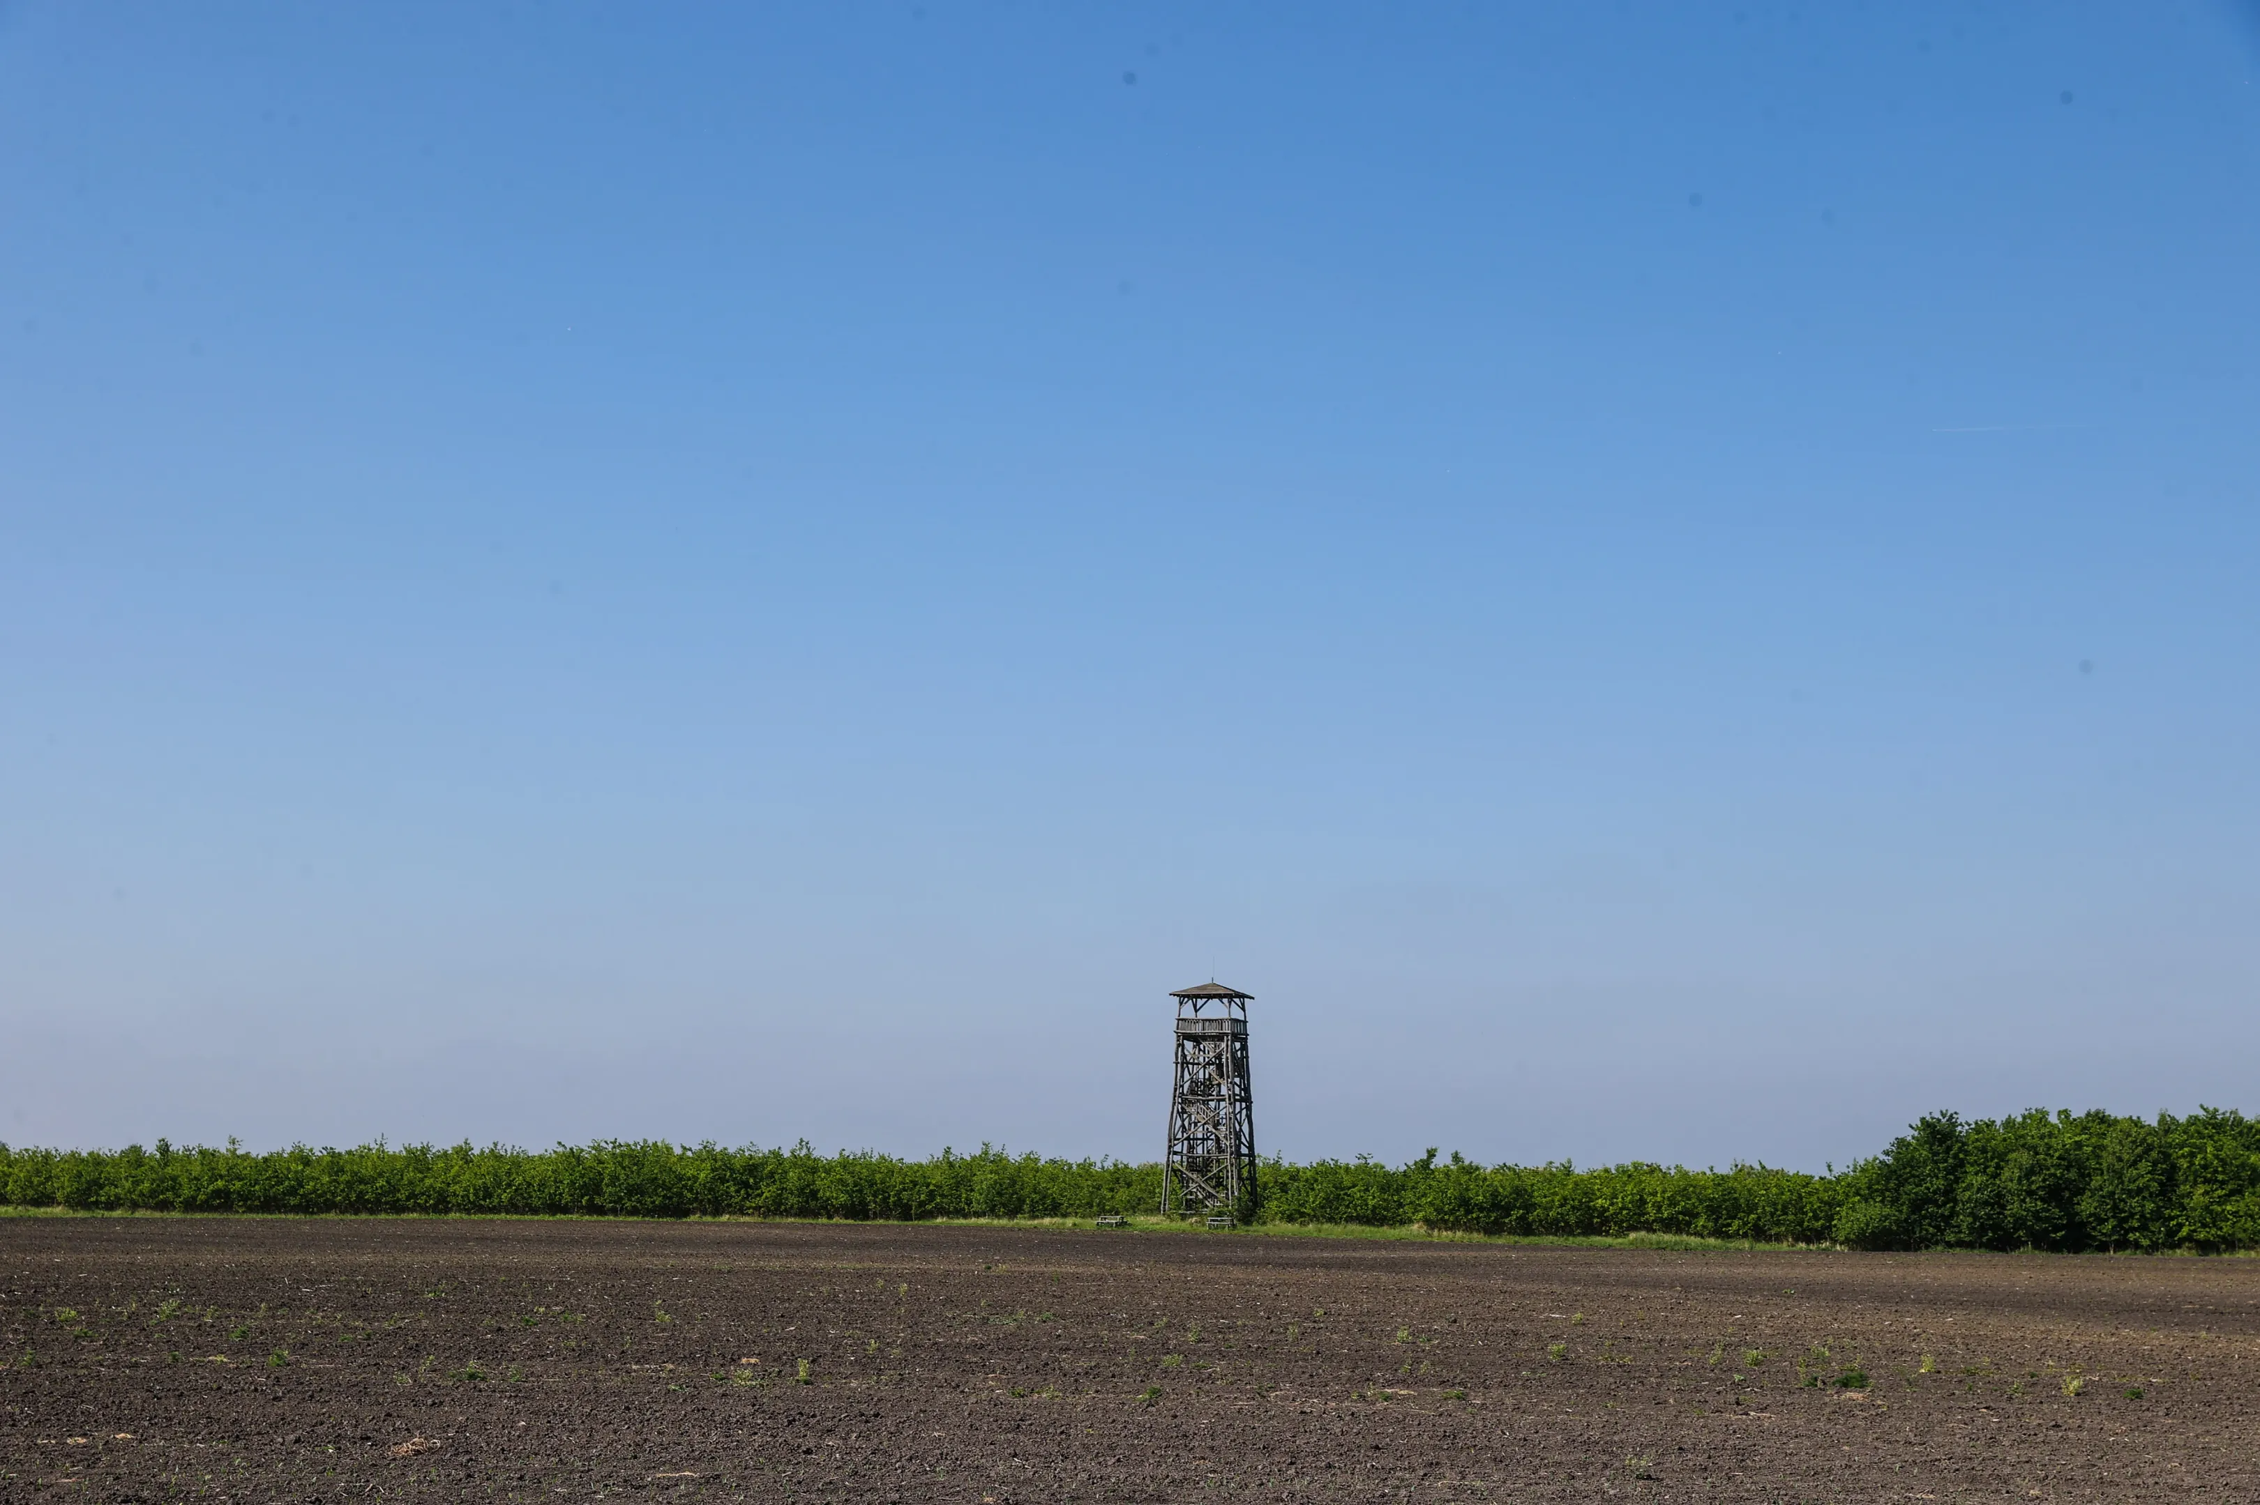
11 wooden observation towers in Tyukod for middle-of-nowhere tourism: almost 700K EUR

Slide 30
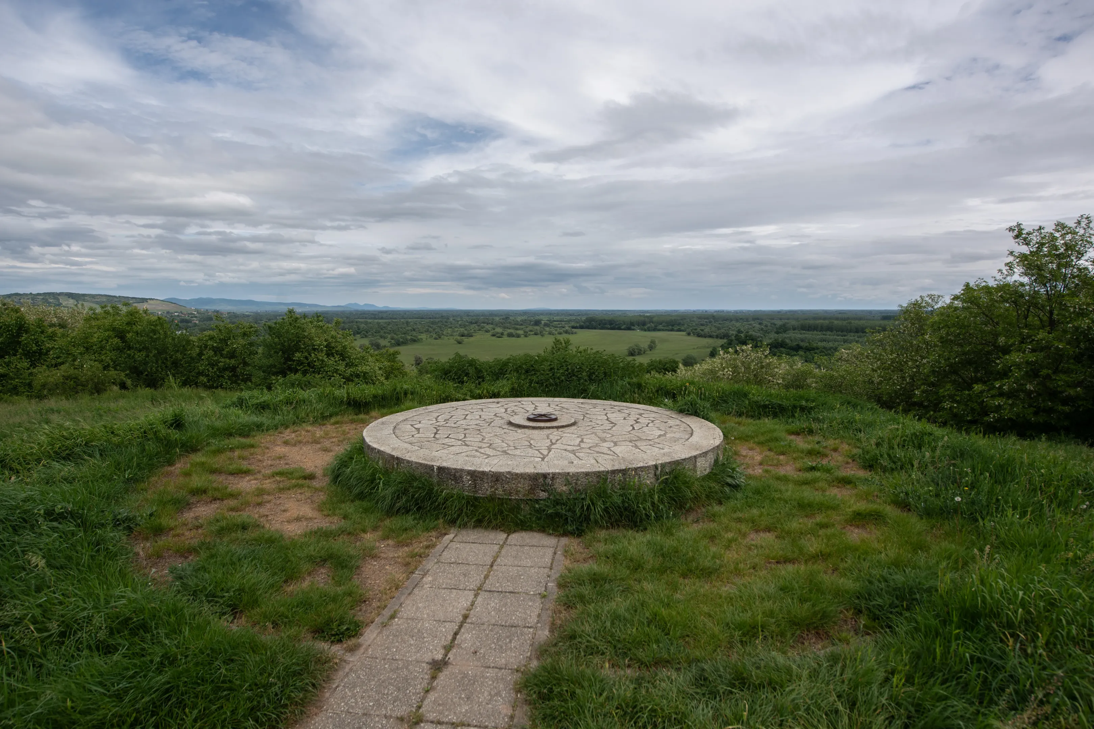
Observation point in Bodrogkeresztúr: 103K EUR

